Slide 1
BLDC MOTOR DRIVEN ELECTRIC SCOOTER
Team 12: Forrest Kaminski, Thuan Pham, Justin Morgan

Slide 2
PROBLEM AND NEEDS STATEMENT
Urban areas are inundated with traffic, making sustainable transport with battery powered scooters is one way to travel short distances quickly without a car, and the hassles of bicycles

Slide 3

MOTIVATION: WHY ELECTRIC SCOOTERS ARE IMPORTANT
Inexpensive personal transport is becoming a larger issue in our ever growing world
Inexpensive solution for short distance travel
Simple and inexpensive to store compared to parking a car in urban areas.
Solution for all ages and physical capabilities

Slide 4

OBJECTIVE
Develop an Electronic speed controller based on an AVR microcontroller
Attach electric Throttle to scooter to control speed from user.
Attach Brushless DC motor to existing scooter frame with belt drive assembly and machined aluminum parts

Slide 5

ALTERNATIVES: WHAT EXISTS NOW?
Existing electric scooters
Electric bicycles
Electric longboards
- electric bikes are expensive and heavy, used on roads with traffic laws.
- Boards are more dangerous and require steep learning curve

Slide 6
REQUIREMENTS
Attach electric motor to existing manufactured kick scooter
Must be throttle controlled with on board microprocessor (not Arduino) via ESC
Vehicle must be capable of moving full sized adult at least 6 MPH
Vehicle range should last more than 2 miles
All running from single 22.2V LiPO battery pack
Quick disconnect for battery safety, and easily rechargeable
Final vehicle materials must cost less than $300

Slide 7
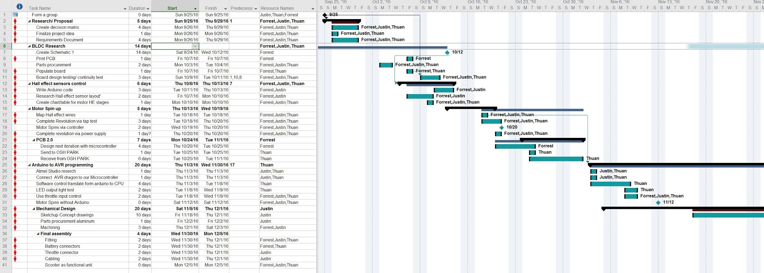
Project Schedule
-Redid in Microsoft Project https://drive.google.com/open?id=0BzepW3rYtsTXeFl4dFlBZktFTHc
Key milestones were:
Schematic 1 design
Motor spin with Arduino
Motor Spin with onboard CPU
Motor Assembly
Full integration

Slide 8
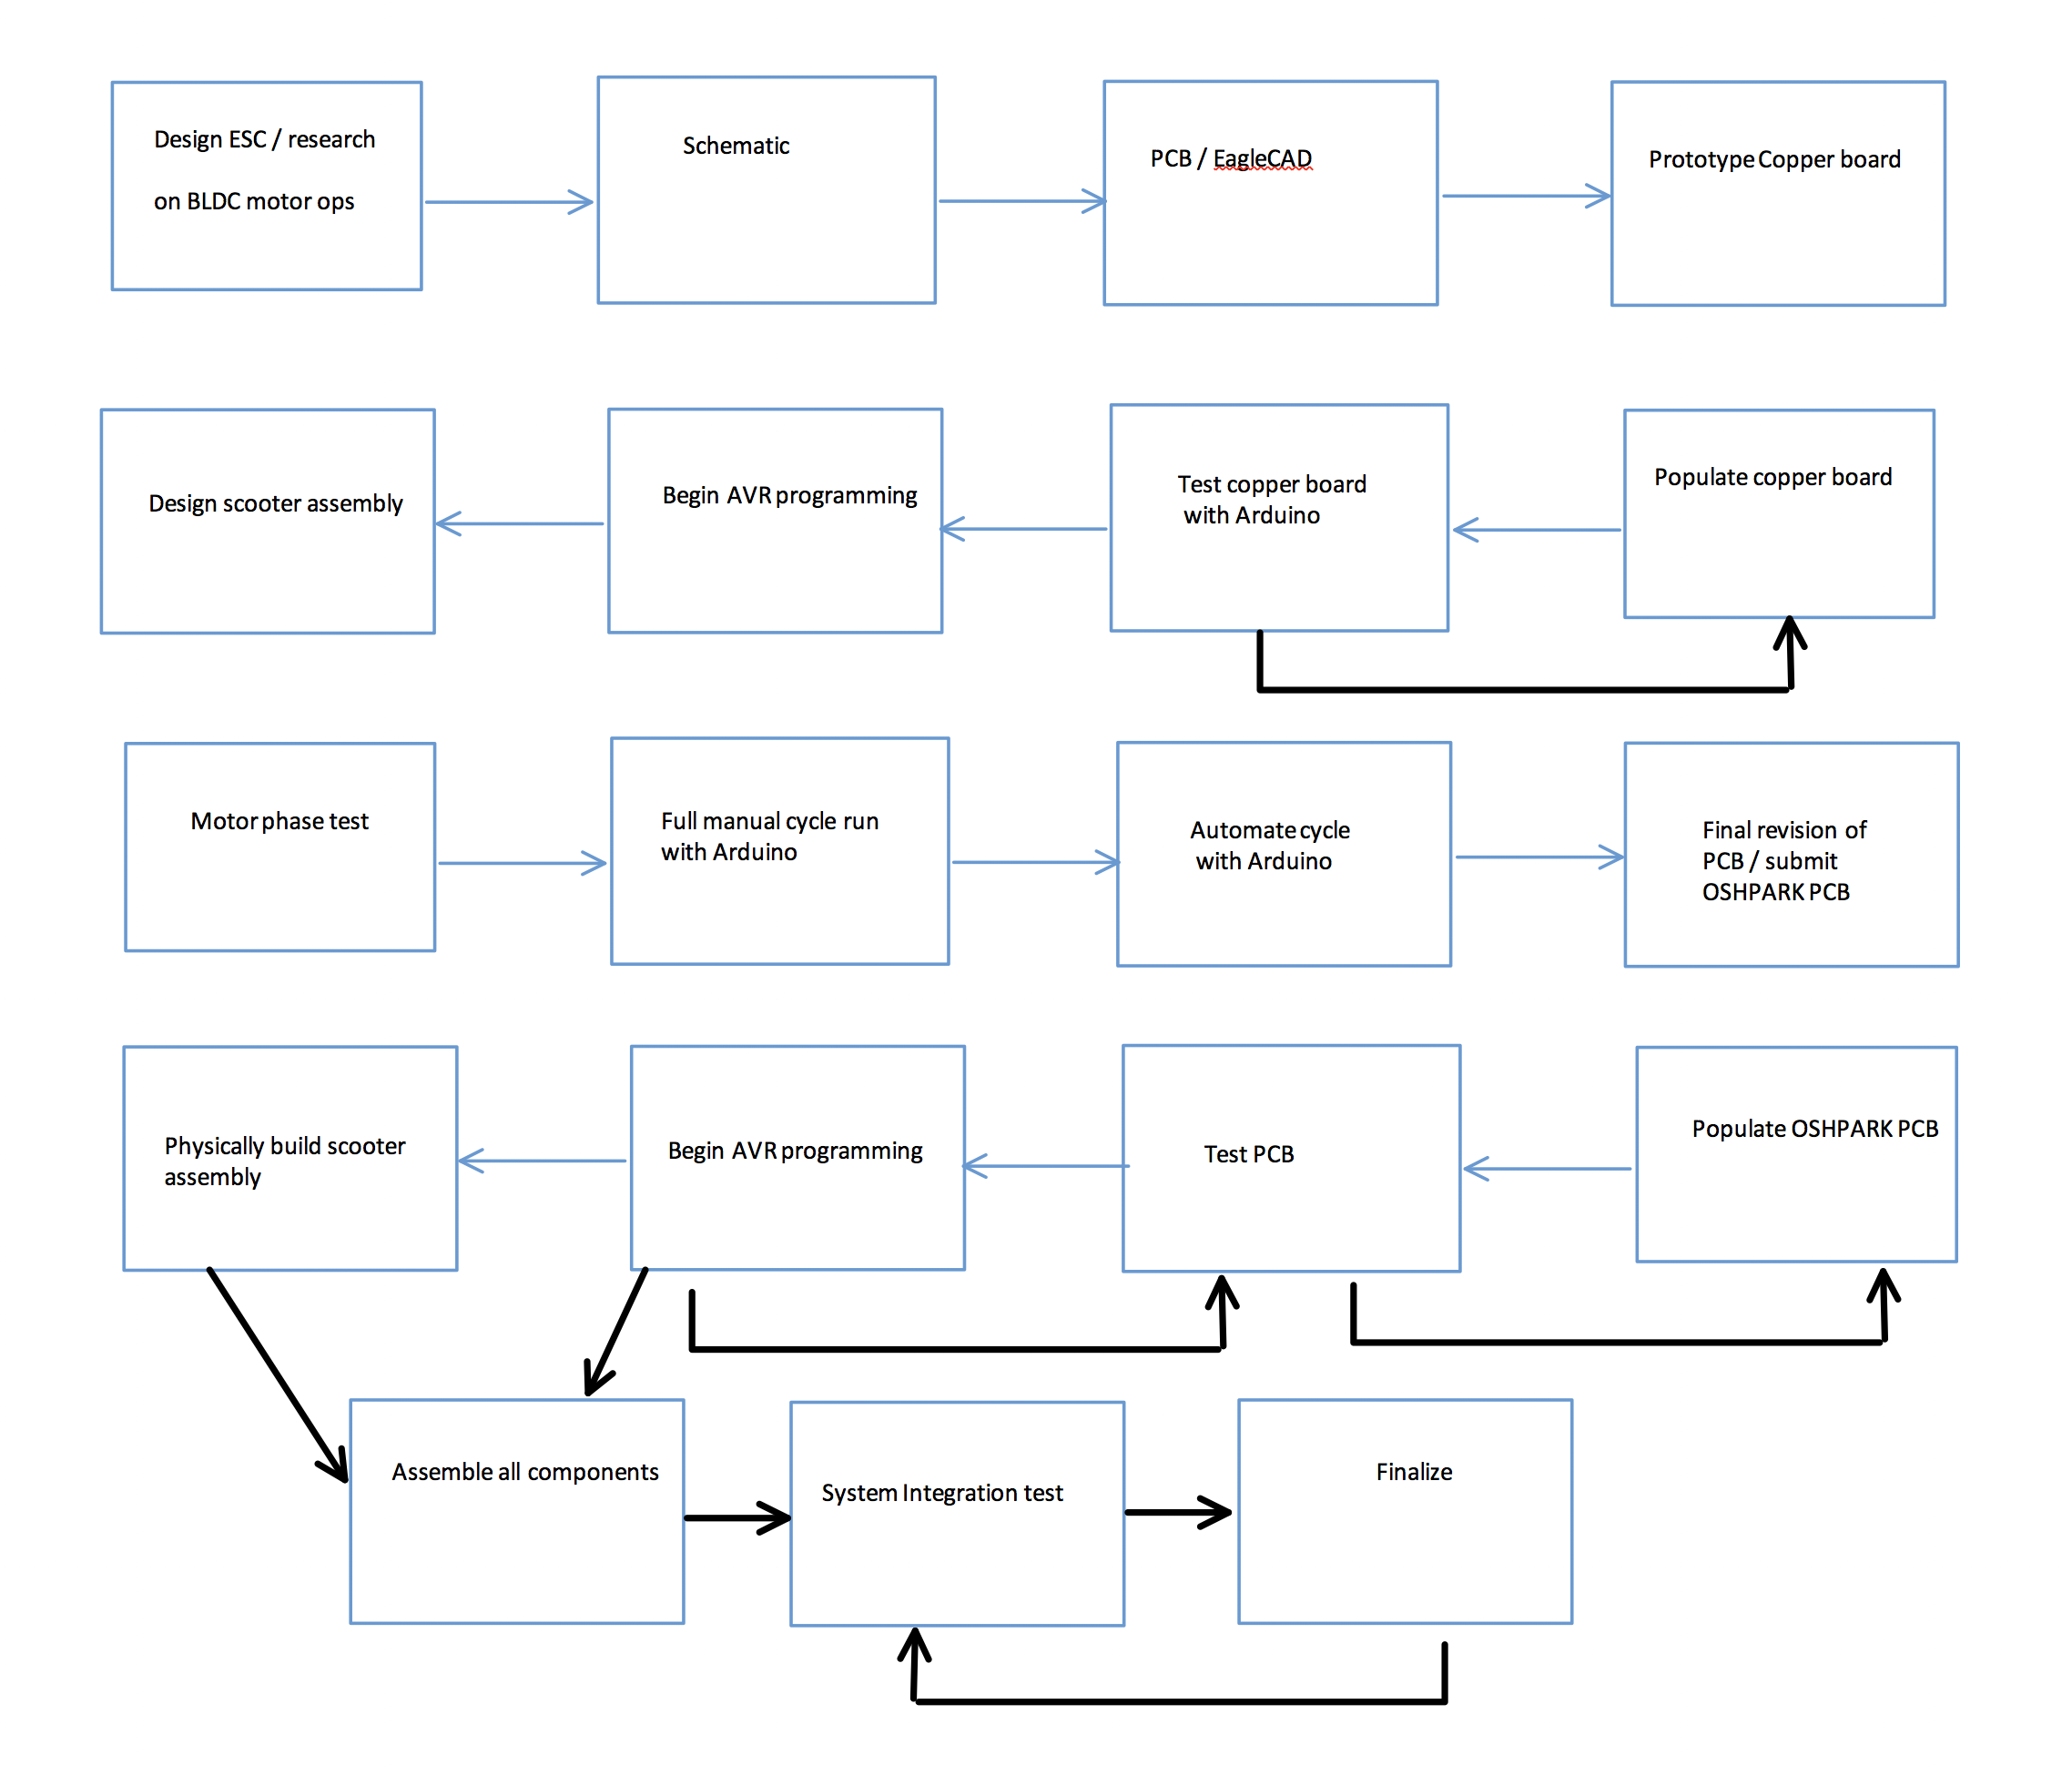
APPROACH: A BRIEF OVERVIEW FOR DEVELOPMENT
Flow chart overview of our stages of development and testing

Slide 9

DESIGN
Agenda –
Algorithms
Hardware Design
Software Design
Microprocessor
Mechanical design

Slide 10
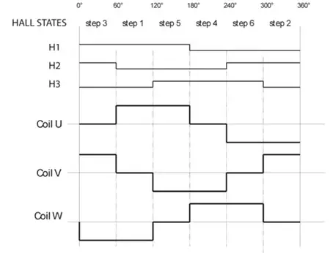
ALGORITHMS: BLDC CONTROL
For non regenerative braking, forward only motor control, there are only 6 states, and they only go in a single direction.

Slide 11
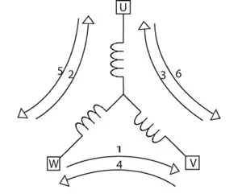
ALGORITHMS: Coil / Magnet Interaction
The states map to physical coils pushing or pulling magnets

Slide 12
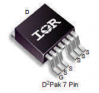
HARDWARE DESIGN: Power Mosfets
IRFS7734
IRFS7734 Power Hexfet:
75V V_{DSS}
197A Continuous Drain Current
600A Pulsed Drain Current
10 - 20V Gate voltage
294W Package Power Dissipation
Datasheet link

Slide 13
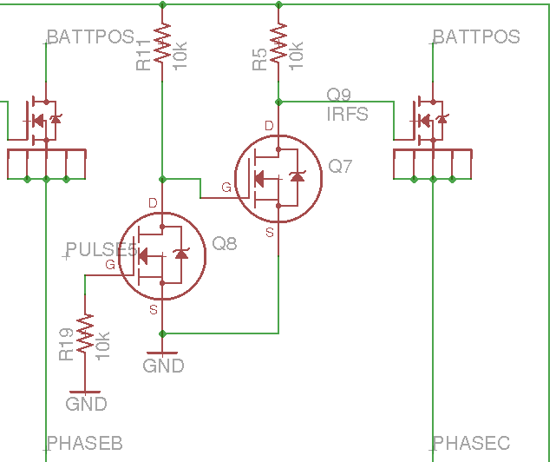
HARDWARE DESIGN: Gate Driver
Gate Driver Circuit:
2n7000 double inverter circuit
Mosfet gate charged through a 3.3k or 10k resistor
Features a gate disconnect switch to mechanically disconnect power mosfets from 15V driving voltage

Slide 14
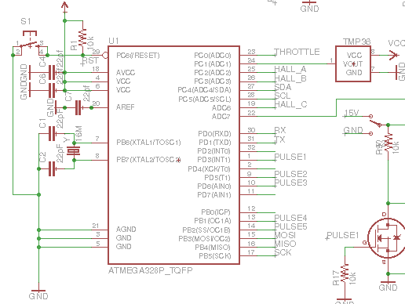
HARDWARE DESIGN: Processor Circuit
Atmega328p Processor circuit:
TMP36 Temperature sensor
Filter Capacitors for power and analog reference
Reset Button

Slide 15
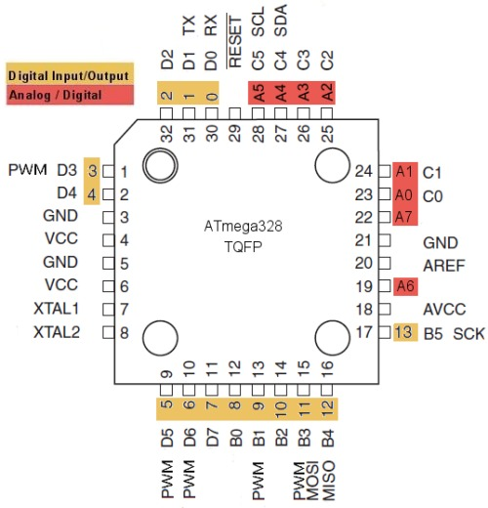
Processor: Atmega 328p
3 Timers/Counters
8Mhz Internal RC Oscillator (Not very Accurate)
Supports up to 20 Mhz Clock w/ External Clock
6 PWM Channels
Several ADC Pins
Digital Pins
Built in pull-up resistors
Cheap and available

Slide 16
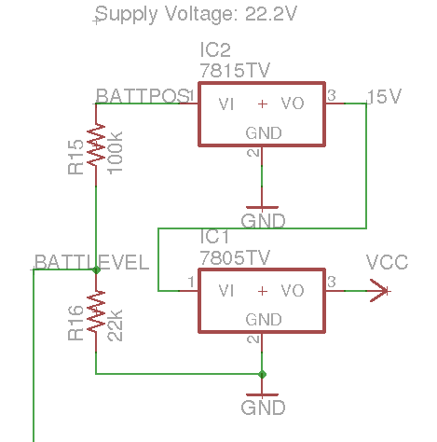
HARDWARE DESIGN: Voltage Regulation and
Filtering
22 - 5V Step Down Circuit
Inputs 22.2V LiPo battery
First Voltage Regulator steps to 15V, used for Power mosfet gate driving
Second Regulator inputs 15V and outputs 5V to power processor and TMP36

Slide 17


SOFTWARE DESIGN:
PWM² control and timed interrupt delays
PWM frequency
Feedback Loop for motor states
C# via Atmel Studio 7
AVR Dragon via ISP programmer
Atmega 328p w/ 16Mhz external crystal clock
Throttle Mapped to Pwm duty cycle/ Speed control
Hall effect sensors with internal pullups
case statement with hall effect feedback to control phase
ISR to create PWM at 300 Hz ontop of 64 KHz hardware PWM

Slide 18
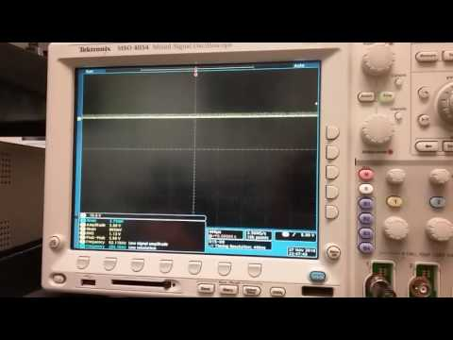
PWM²
Gate not charging up fast enough for adequate throttle control. High frequency pwm is efficient, but only turns on mosfet for a short amount of time. To circumvent this, we overlaid a second software of pwm.

Slide 19
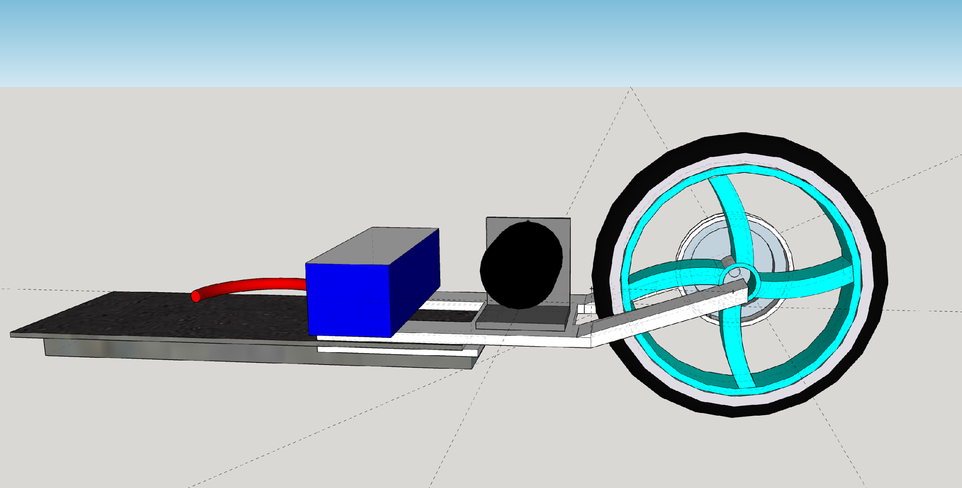
MECHANICAL DESIGN:
Used sketchup pro
Rudimentary design to see how overall fit and finish will be
Real design differs slightly for ease of manufacture

Slide 20
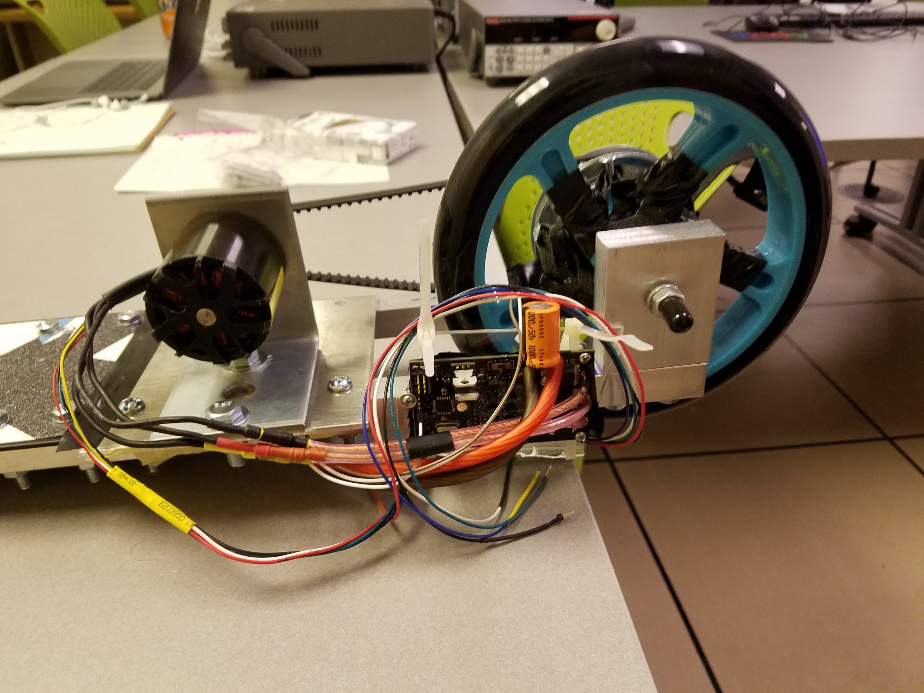
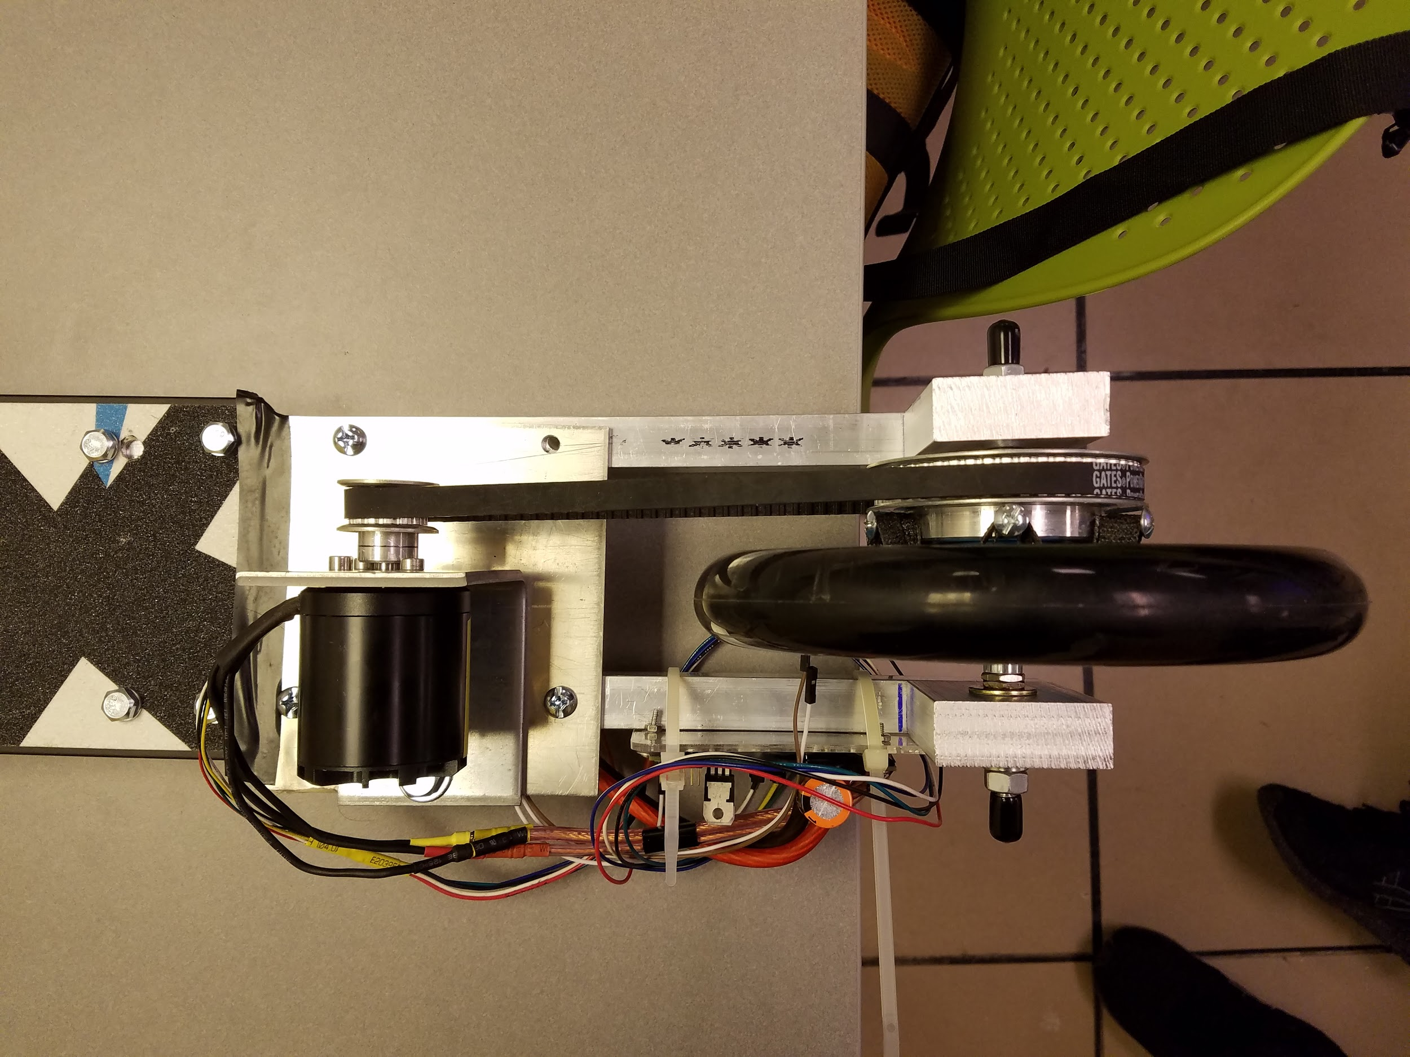
Scooter base
picture of our build

Slide 21
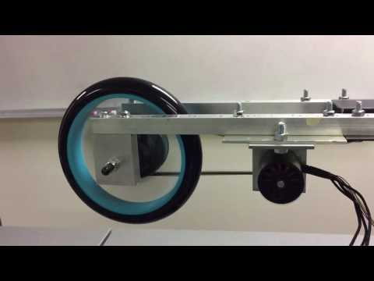
Demo of Running Scooter

Slide 22
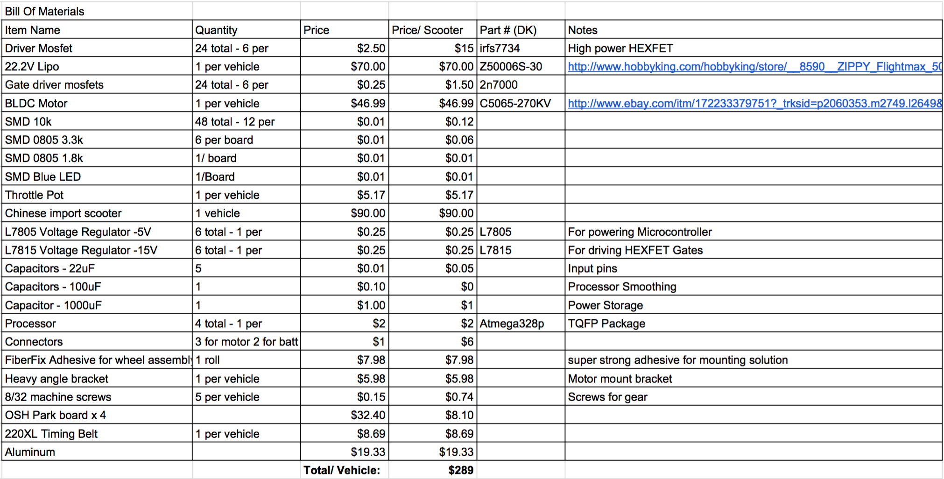
BILL OF MATERIALS

Slide 23
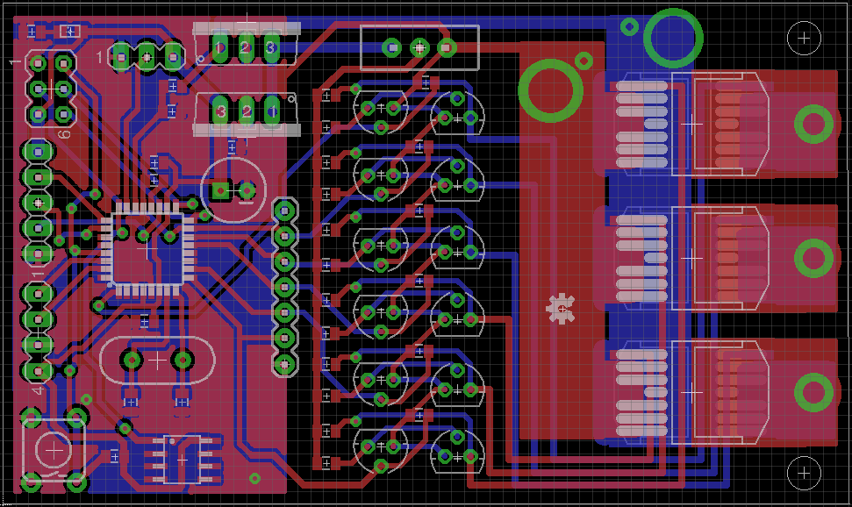
BOARD LAYOUT 2:
2nd generation, viewed in EAGLECAD
Updated mounting holes and large vias for power cables and Hall effect sensors
Contains microprocessor control

Slide 24

IP & PRIOR WORK
Open sourced project
No pre existing code or PCB layout used
Constructed from ground up

Slide 25

TESTING
Unit Test
-Logic Level switching Mosfets
-Power Mosfets
-Hall Effect Sensors
-Motor Phase/Brushless Motor
-Potentiometer
-PWM Outputs on Logic gates
-ISP Programmer Port
-External Clock
-Microprocessor/Atmega328p
System Test
-Speed Controller Circuit
-Motor with Throttle Control
-Scooter + motor + Throttle Handle
Arduino
-Pre Design Phase
-Software Test Bench
-Serial Port

Slide 26
RESULTS: WHAT WORKED
Scooter with modified assembly functions as a regular scooter (sturdy, supports weight)
Electric motor and belt drive functions as a drivetrain
Fully functional throttle speed controller
Microprocessor is superior to the setup on the Arduino
Scooter run as full functioning unit with attached battery

Slide 27
LESSONS AND OUTCOMES: WHAT DIDN'T WORK
Circuit is fragile, 2N7000 transistors are weakest link
MOSFET switching is not fast enough
Heat dissipation was poor, needed proper active cooling on MOSFETS
Needed smoother wheel and bearings to reduce friction on gear
Fitting all components on system needs optimizing
Copper boards are terrible for prototyping;
Solder bridging No. 1 reasons for issues
PWM wave can be stacked with additional waves
CHECK YOUR CONNECTIONS, polarity

Slide 28
IDEAS FOR IMPROVEMENT
On board TMP36 heat sensor is unused, and would be far more useful much closer to the power mosfets
Implement PID control to smooth the change in power delivery to the motor so as to not risk overcurrent
Change mosfet gate driver’s circuit to something much faster and safer
Need proper braking system; regenerative is possible given hardware
Change the throttle and HallC pins for pullup resistor usage
Reverse polarity protection to ensure no accidental destruction of built in mosfet rectifiers
Re-assign pins from microprocessor: hall Effect, throttle
Need proper heat dissipation on all six MOSFETS
Replace screws with something 1 inch instead of quarter inch for more clearance,
Physical appearance improvements: more precise machining, better circuit protection from elements.
Implement a new gate driver to improve switching speed
Implement FTDI chip for USB serial communication for debugging
Speedometer, appearance improvements
Battery voltage could be readout via usb or serial
Ideally, a 300A fast blow resettable fuse would be in line with the battery

Slide 29
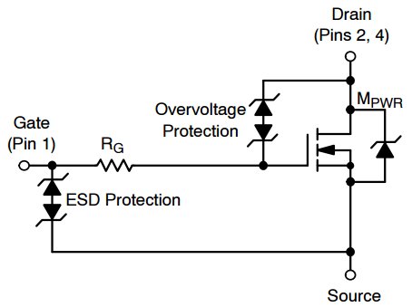
Mosfet Gate Protections
Our Mosfets would be made far more durable by implementing a TVS or some form of Zener protection. A zener with a breakdown of 16-19V would be capable of protecting the power mosfet gates from being overvolted or damaged by ESD, which proved to be a huge problem on prototype boards.

Slide 30
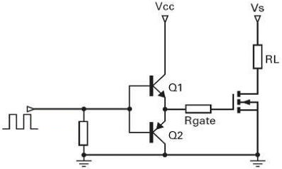
Mosfet Gate Driver
A PNP and NPN transistor is typically used to hard drive a power mosfet gate, given a Vcc between 10 and 20V. Our implementation drove our mosfet through a 3.3k and 10k resistor, which was ultimately too slow and resulted in significant power output limitations

Slide 31
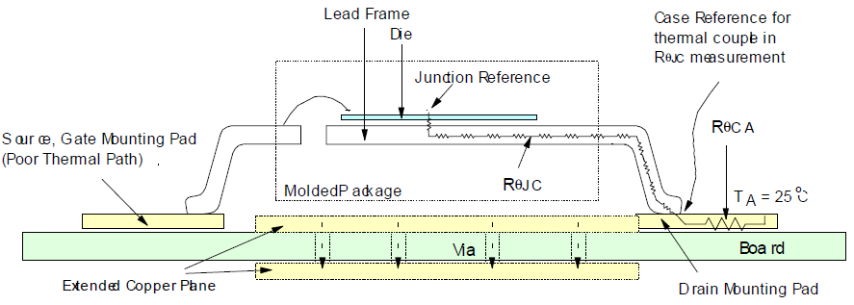
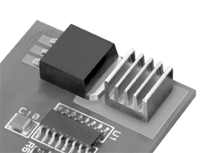
Mosfet Thermal Build-up
Mosfet heat dissipation became a huge problem at high loads. The D²Pak package has an excellent power dissipation at 350W, but we ended up still having massive thermal buildup in the local board area and in the package itself. Heat dissipation can be improved with thermal vias to increase surface area, or nearby heatsinks on exposed copper pads presuming it does not interfere with connections.

Slide 32
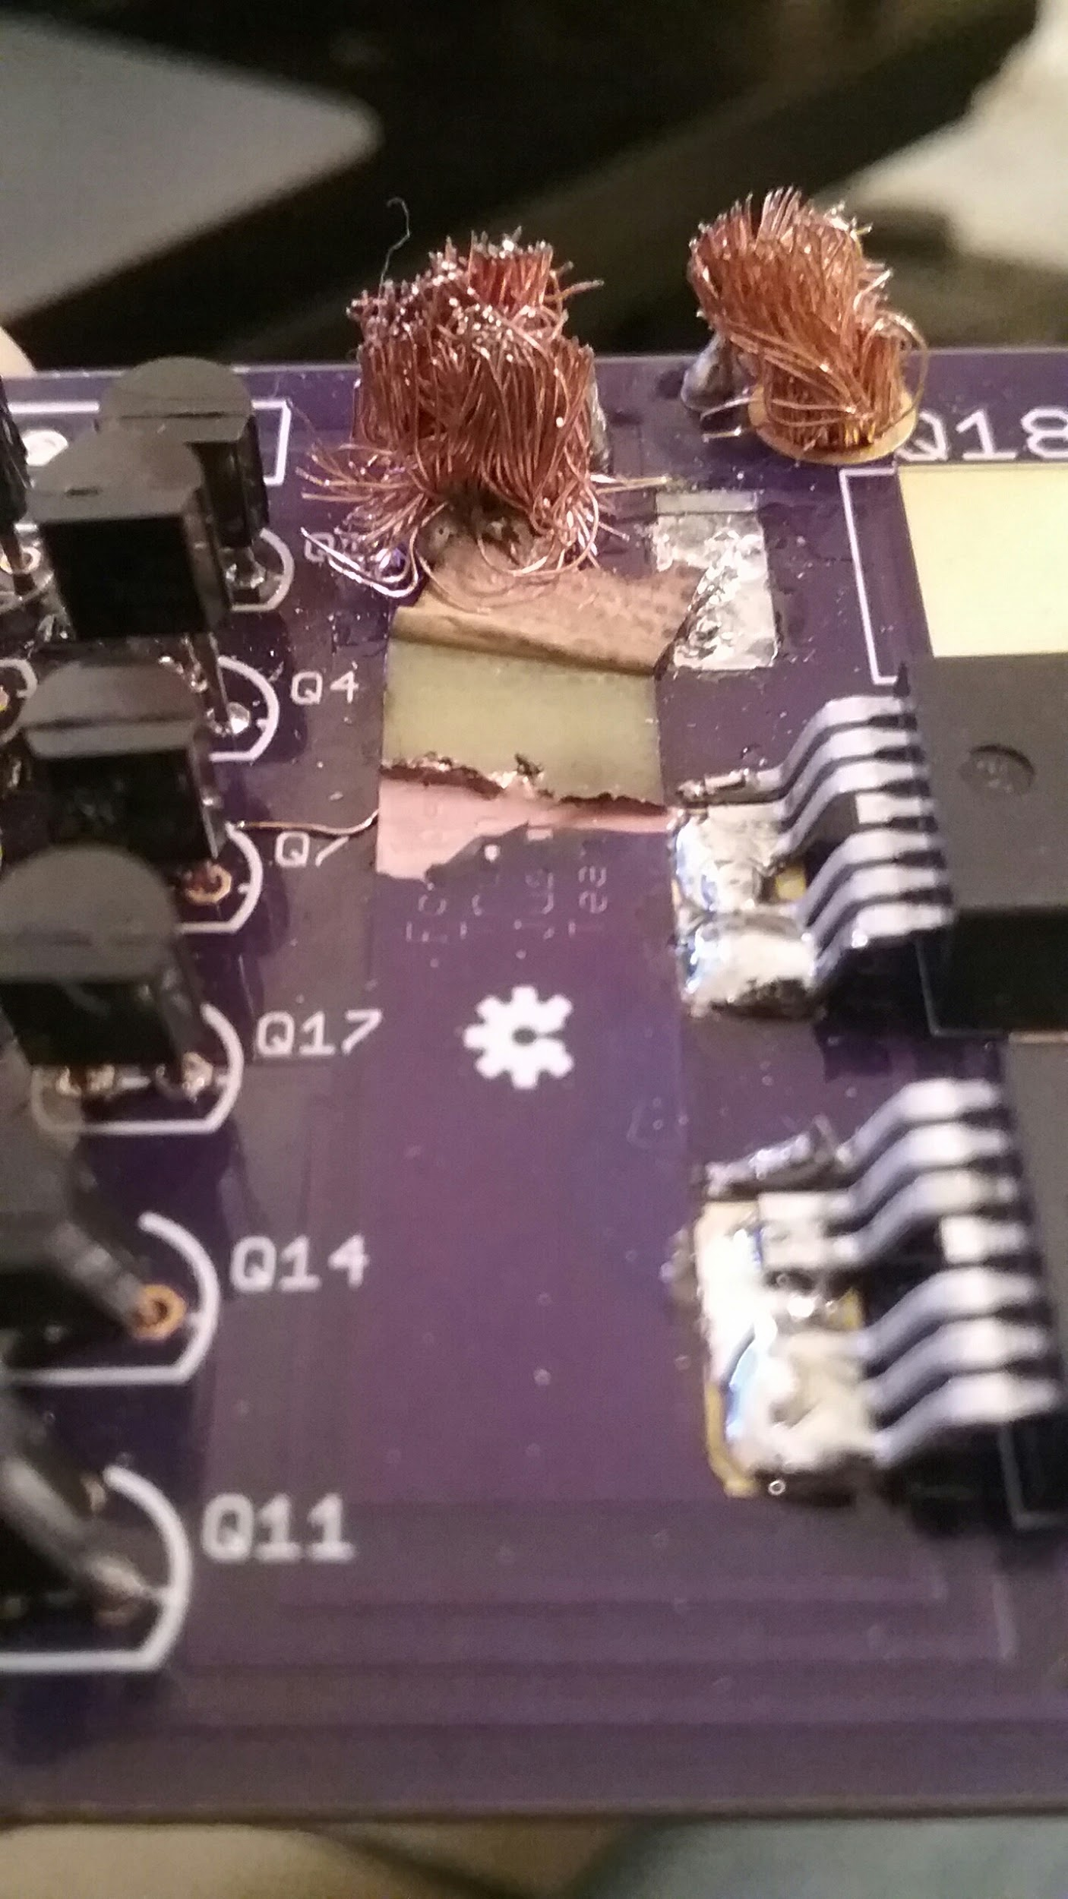
Major Design Issues
Our gate driver circuit, while functional posed a huge risk to the overall system should a 2n7000 experience a failure. When exposed to the entire current of a power mosfet gate discharging, it has the potential to seize operation, driving the mosfet high and creating a blast through situation, leading to...
Insert gate driver circuit

Slide 33
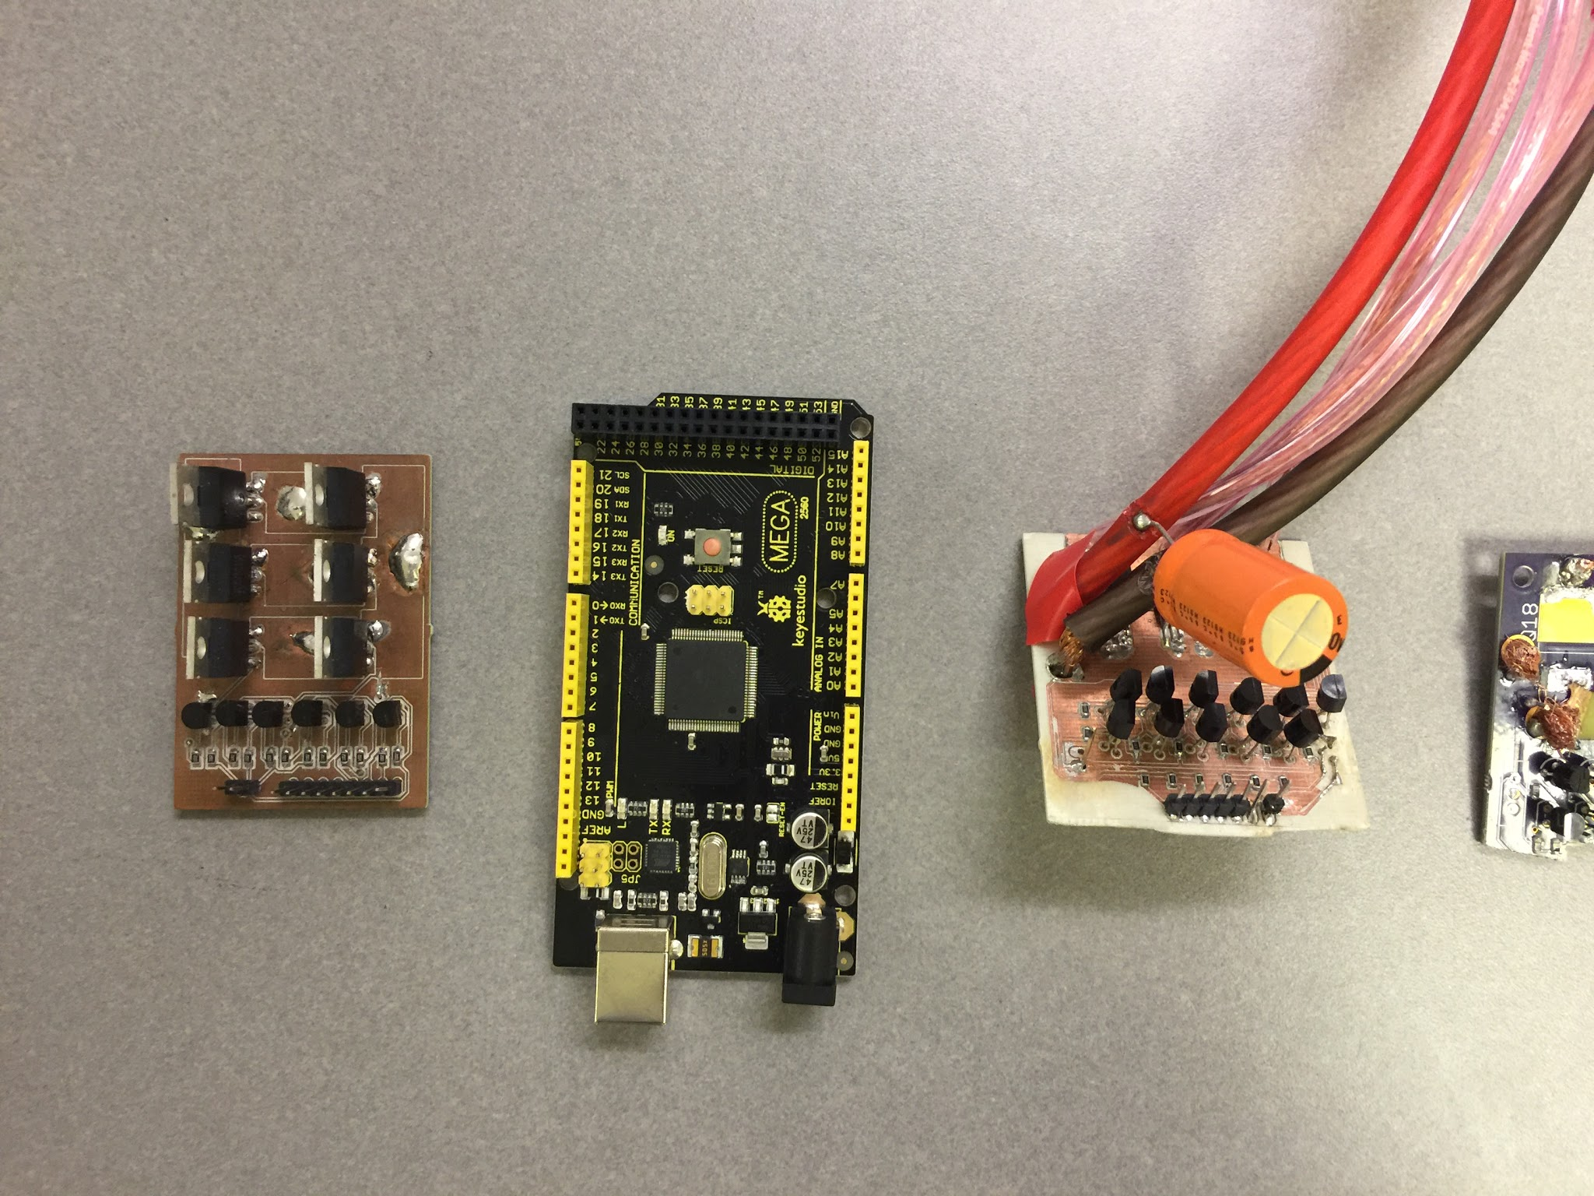
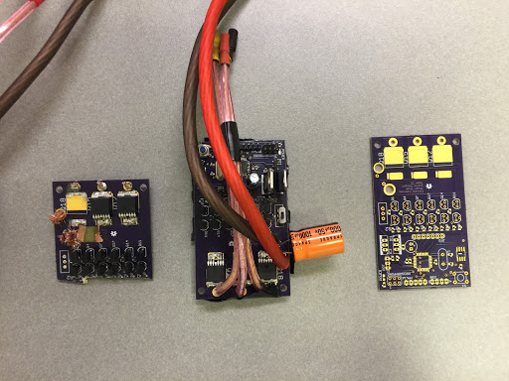
Iterations

Slide 34

CONTRIBUTIONS
Forrest – Overall electrical design and board layout, schematics, soldering, machining
Thuan – Microprocessor AVR programming, Arduino programming, Board assembly
Justin – Mechanical/machining design and parts procurement, some arduino programming, some soldering
All reviewed board design

